Slide 1



Water Quality Prediction
Student Name: Prarthna Puhan
AICTE Student ID: STU658c808d6f68b1703706765
AICTE Internship ID: INTERNSHIP_1746416864681834e0e35d8

Slide 2

Learning Objectives
Understand the basics of machine learning and regression techniques
Learn how to implement a Random Forest Regressor for multi-output prediction
Understand key evaluation metrics like MSE and R² Score
Learn how to preprocess categorical and numerical data
Gain hands-on experience in building and training ML models using scikit-learn
Deploy a simple web app using Streamlit
GOAL
Source :
www.freepik.com/

Slide 3







Tools and Technology used
Python – core language for modeling and preprocessing
Pandas, NumPy – for handling and analyzing tabular data
scikit-learn, XGBoost, LightGBM – for building predictive models
Joblib – for saving and loading .pkl model files
Streamlit – to build the interactive web-based UI
Jupyter Notebook / VS Code – development environments
Correlation Analysis – for exploratory data insights
Machine Learning Models Used:
Random Forest Regressor
Gradient Boosting Regressor
Linear Regression
Stacking Regressor (Final Model)
RidgeCV (used as meta-regressor)
MultiOutputRegressor (for multi-target regression)

Slide 4
Methodology
Data Preparation • Cleaned water quality CSV data • Extracted year and month from date • One-hot encoded station IDs
Handling Missing Values • Applied interpolation, forward and backward filling to avoid dropping null values • Ensured data continuity for modeling
Target & Classification • Predicted 9 pollutants (e.g., NH4, NO3, CL, etc.) • Labeled quality as Good, Moderate, or Poor based on thresholds

Slide 5
Methodology
Model Building • Tried multiple regressors: Random Forest, Gradient Boosting, XGBoost, LightGBM, MLP, Linear Regression • Final model: Stacking Regressor (with base and meta models) • Stacking improved R² and MSE values over individual models
Evaluation Metrics • Used R² (explained variance) and MSE (error magnitude) • Also assessed water quality prediction accuracy
Deployment • Built a user-friendly Streamlit web app • User inputs: Station ID & Year • Outputs: Predicted pollution levels + Visual summary + Pollutant Hazards

Slide 6
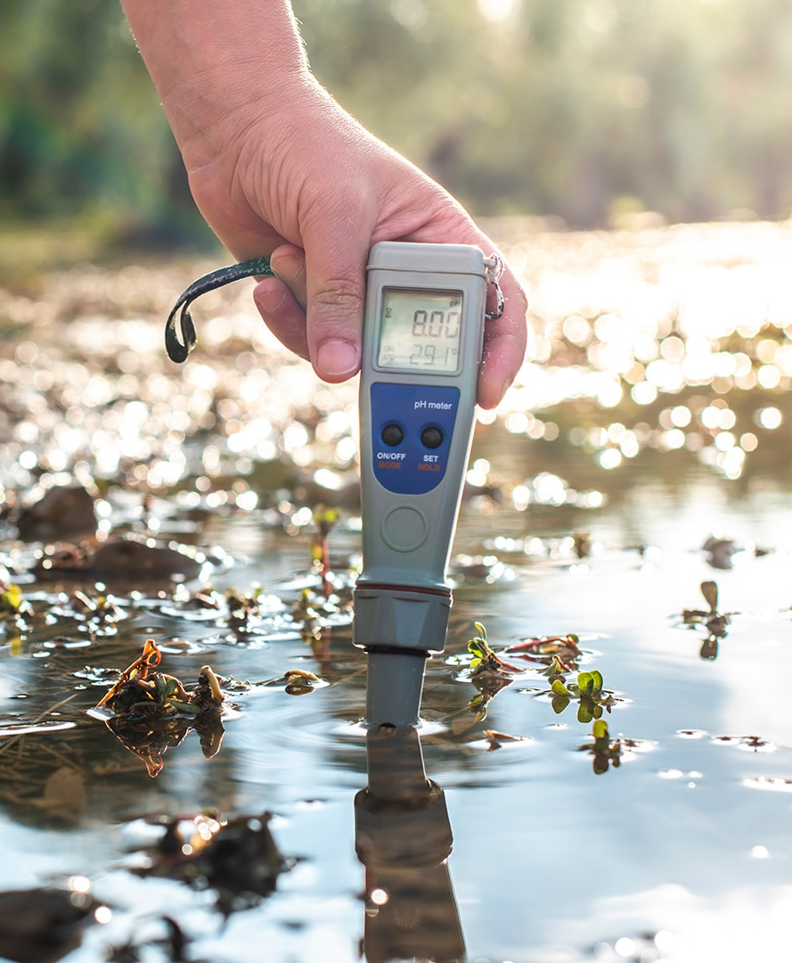
Problem Statement:
Why Water Quality Prediction Matters?
Water pollution poses serious risks to human health, aquatic life, and agriculture
Existing monitoring systems are often manual, delayed, and limited in scope
Lack of early warning systems leads to reactive rather than preventive measures
Predictive modeling enables data-driven decisions, reducing long-term damage
Supports targeted interventions by forecasting pollution levels station-wise and year-wise

Slide 7
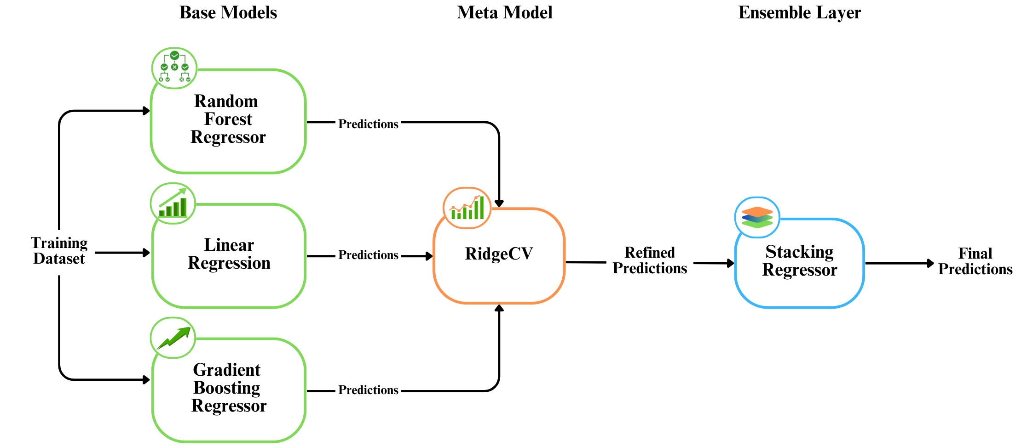
Solution:
Built a Stacked Ensemble Regressor to forecast pollutant levels between 1995 and 2050
Base models: Random Forest, Gradient Boosting, Linear Regression and Meta model: RidgeCV
Used MultiOutputRegressor to predict all 9 pollutants simultaneously
Input: Year and Station ID
Output: Predicted pollutant levels + Good / Acceptable / High status

Slide 8
Solution:
Why Stacking?
Individual models showed inconsistent performance
Stacking combined their strengths, improving overall R² and MSE scores
Missing Data Handling
Instead of dropping nulls, used interpolation, backward fill, and forward fill
Ensured important data was retained, preserving time-series continuity
Evaluation Metrics
R² Score: Measures how well predictions match actual values
MSE (Mean Squared Error): Penalizes large prediction errors
Both are essential for continuous numeric data
Deployed as a Streamlit web app
Includes interactive inputs, colored status indicators, a summary bar chart and ill effects of water pollutants

Slide 9
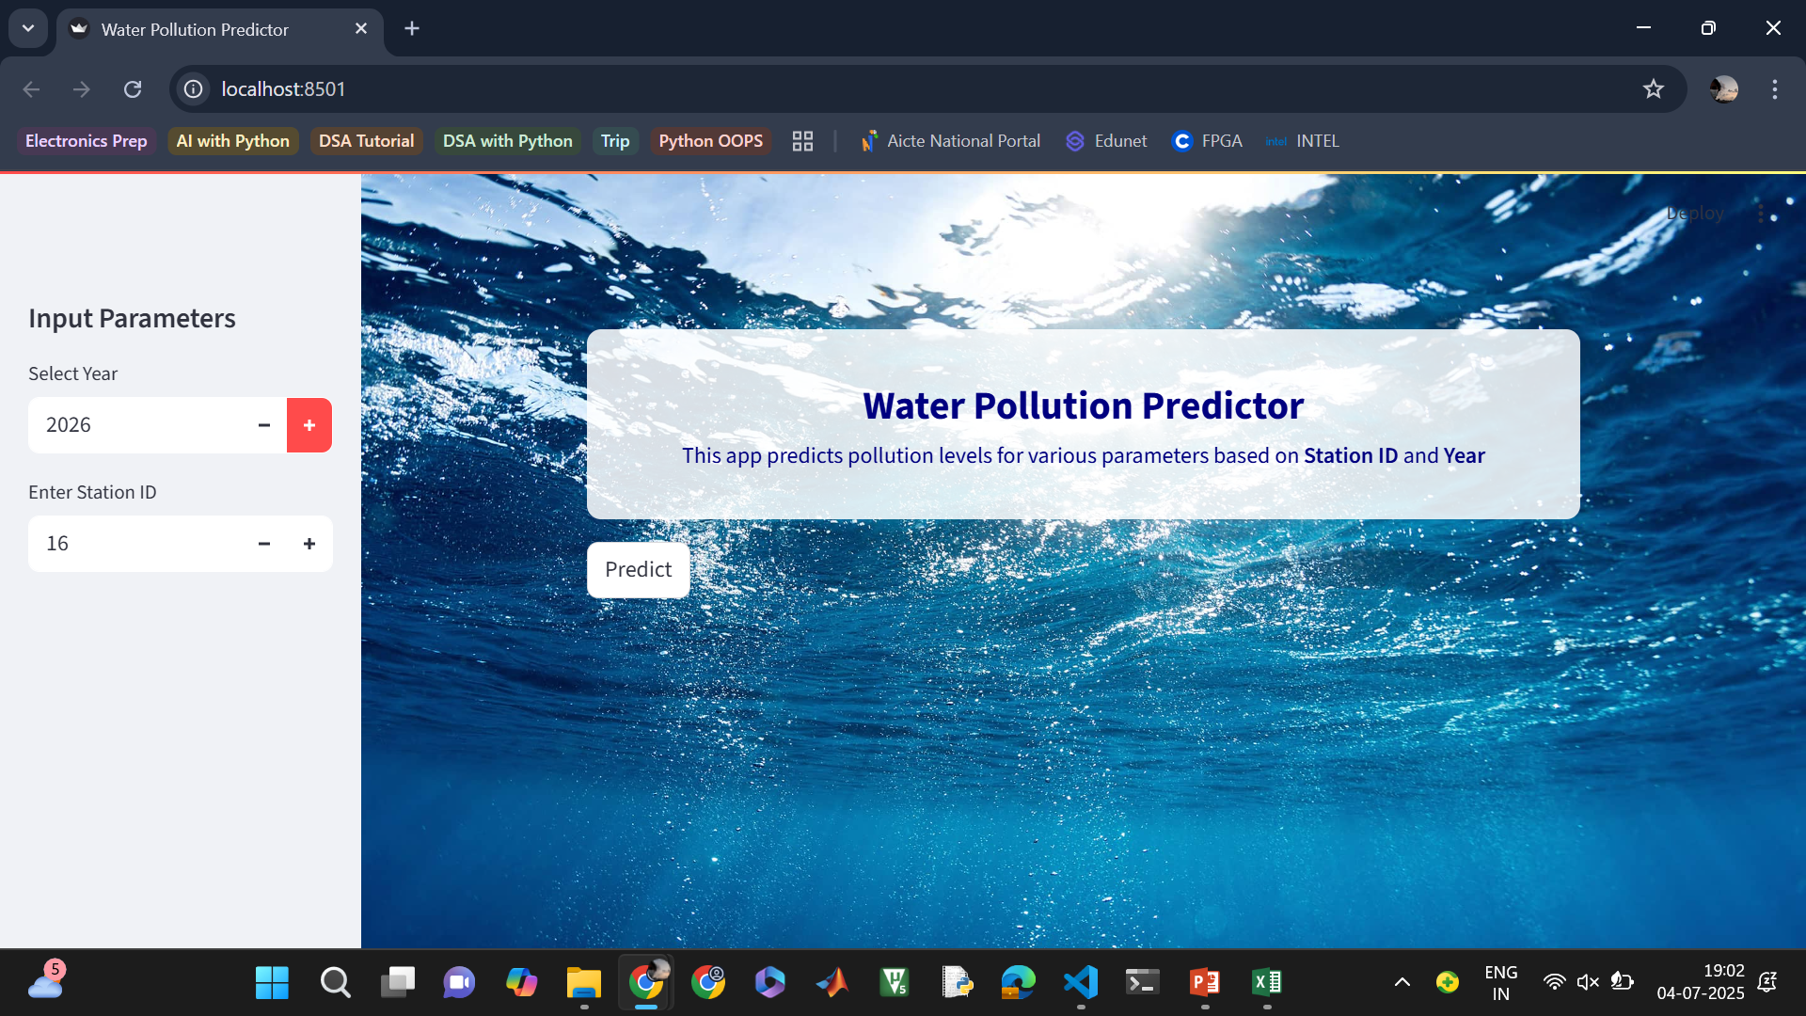
Screenshot of Output:

Slide 10
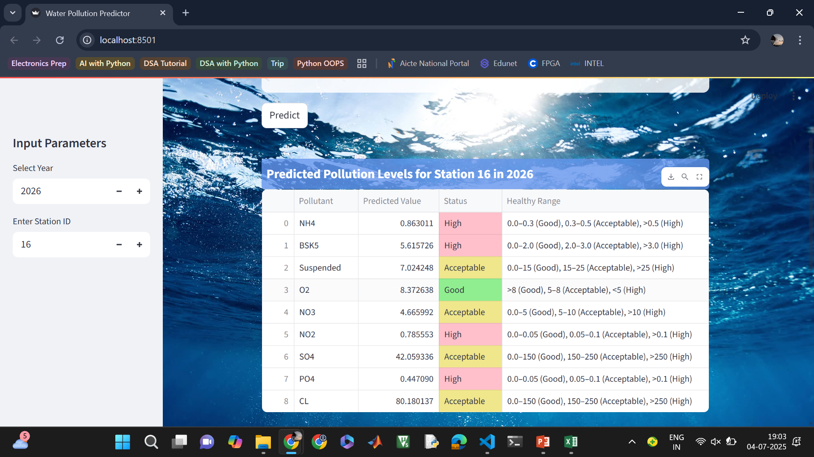
Screenshot of Output:

Slide 11
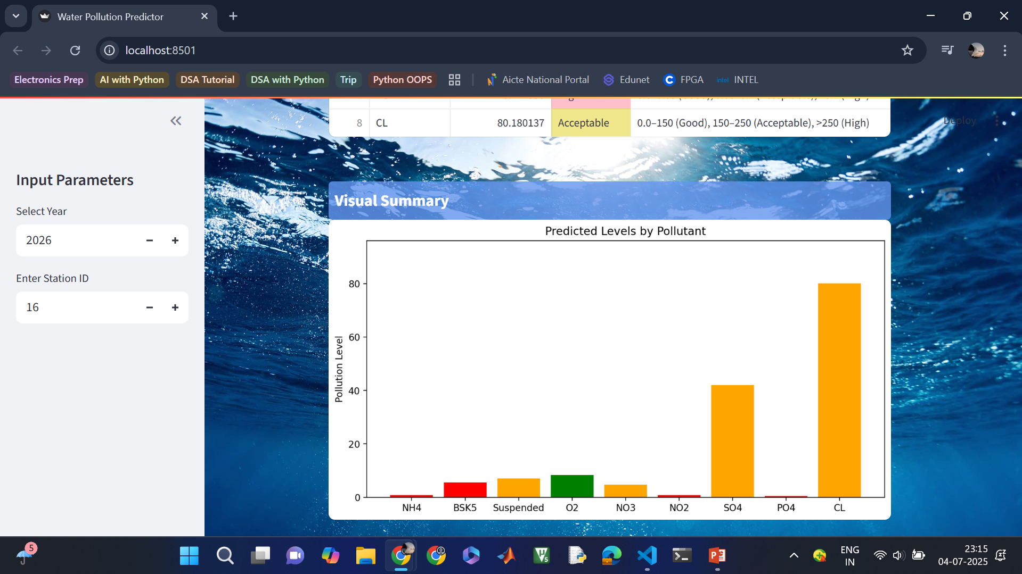
Screenshot of Output:

Slide 12
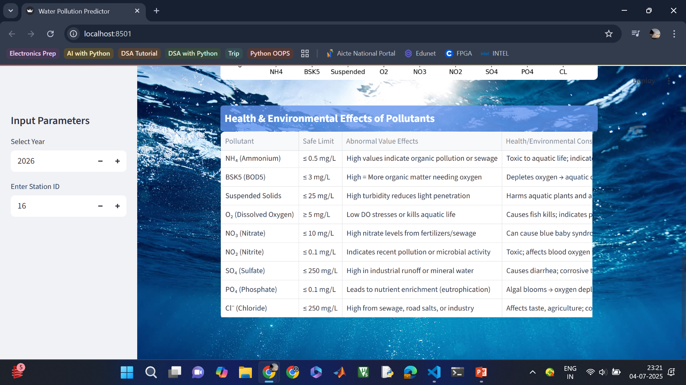
Screenshot of Output:

Slide 13
Conclusion:
Developed a multi-output pollution prediction system
Achieved strong performance using Stacking Regressor
Added classification logic for decision-making
Interactive web app built with custom styling for better usability
Future Scope
Add more input features: rainfall, population, industrial activity
Use real-time sensor integration for live forecasting
Include map-based visualizations for geographic insight
Extend app to include water quality class predictions (e.g., Safe, Unsafe)
GitHub Link: https://github.com/prarthnaaa/Shell-AICTE-Internship_Water-Quality-Prediction.git

